Slide 1
Energy–Accuracy Tradeoffs in Neuromorphic vs. GPU-Based Time-Series Forecasting
Souvik Pramanik
Advisor: Yang (Cindy) Yi
March 23rd, 2026
Notes:
Today I will be talking about Energy-Accuracy Tradeoffs in Neuromorphic vs Time-Series Forecasting.

Slide 2
Overview
Introduction
SNN and ANN architectures
Datasets
Evaluation
Results
Hardware‑Validated Benchmarking Analysis on Loihi 2 and GPU Platforms
Conclusions
Future Works and Current Updates
Notes:
Giving an overview of what this presentation contains: I’ll give an introduction to neural network concepts and a literature review of how I got to my SNN and ANN architectures. I get into these architectures and introduce the datasets used to test them. Next, I’ll go over how these architectures are evaluated after testing with these datasets including the energy consumption of these models. Later, the results of the datasets with all the architectures are looked at and comparisons of these architectures are made with previous work on Loihi 2 and GPU platforms. Conclusions are drawn and the presentation is wrapped up with future works and current updates.

Slide 3
Introduction
Spiking Neural Networks (SNN) Overview
Loihi 2 Overview
Literature Review
Problem Statement
What is Ring Buffer?
Why Ring Buffer?
Ring Buffer Visualization
Main Contributions
RingSNN Approach
Notes:
I’ll discuss already known literature about Spiking Neural Networks or SNNs and how they’ve been deployed on Intel Loihi Neuromorphic Hardware and how they have been used for classification and event-driven datasets by reviewing their literature studies and highlight the difficulties of SNN. I introduce the concept of what a RingBuffer is and how I got to the RingBuffer SNN (RingSNN) model and the contributions behind it.

Slide 4
SNN Overview
Spiking Neural Networks (SNNs) resembles biological neurons by communicating through discrete time and event-driven, binary spikes rather than continuous values.
Have emerged as an upcoming approach in improved time-series forecasting by enabling modeling of complex temporal dependencies and perfecting prediction accuracy
Designed to process temporal, sequential data through event‑driven spiking activity
Efficiently handles rare events with lower energy -> enabling forecasting on resource-constrained devices
While SNNs offer biologically inspired event-driven computation, their application to regression-style time-series forecasting remains underexplored
Notes:
(Read off SNN Overview. Then mention the following.).
(2nd Bullet Pt.): Mention “making them well‑suited for capturing dynamic patterns and long‑term dependencies in time‑series signals”
(3rd Bullet Pt): Their ability to operate on infrequent events combined with energy-efficiency makes them suitable for real‑world forecasting tasks on resource‑constrained devices

Slide 5
Loihi 2 Overview
Recent advances in neuromorphic computing have further improved capabilities like Intel Loihi 2
Research of SNNs implementation on Loihi 2 did not address practical bottlenecks such as memory access, idle vs. active power states, communication overhead, and hardware inefficiencies [2]
Recent studies emphasize the need for reproducible, hardware-validated benchmarking protocols that account for decomposed energy states and task-specific performance metrics
Notes:
(Read off Slides for Loihi 2 Overview)
(After mentioning bullet pts.): I’ll go over in more detail about the SNN implementations on Loihi 2 and the recent literature that I’ve looked at with regards to Loihi 2 and hardware-validated benchmarking protocols.

Slide 6
Literature Review
Davies in [2] introduced the Loihi neuromorphic processor and demonstrated its on‑chip learning capabilities, but their focus was primarily on classification and optimization tasks rather than regression‑style forecasting
Other research using Loihi processors has demonstrated significant gains in speed and energy efficiency for relevant workloads compared to conventional CPUs and GPUs like Matsuo et. al. in [3]; however, the authors in [3] did not extend into forecasting with benchmarking.
Bhattacharjee et. al. in [4] challenges prevailing assumptions about the energy efficiency of SNNs in their work, showing that algorithmic claims overlook the bottlenecks like hardware limitations and memory access; the findings emphasize the need for hardware-specific protocols and caution against relying solely on algorithmic sparsity or spike-count metrics; however, while they highlight systemic hardware challenges, they did not demonstrate how neuromorphic platforms perform in practice for real-world predictive tasks
Notes:
These slides highlights the literature that was inspired for this work. Going over these works (Read off Slides for Literature Review)

Slide 7
Literature Review
In the paper presented by Yan et. al. [8], the authors evaluate SNN energy efficiency but focus on total energy consumption rather than decomposed energy states like idle, active, and spike‑driven
Prior work on SNNs has highlighted hardware bottlenecks [7], theoretical efficiency bounds ([5], [8]), algorithmic innovations like pruning and hybrid architectures [9], and application benchmarks in domains like self‑driving [6] and time‑series forecasting [1]
Overall, prior research has concentrated on classification tasks, optimization problems, continuous‑valued predictions, theoretical energy bounds, memory‑access, and hardware limitation issues.
None have benchmarked regression‑style forecasting on Loihi 2 with energy measurement protocols that explicitly account for decomposed energy states
Notes:
These slides highlights the literature that was inspired for this work. Going over these works (Read off Slides for Literature Review)

Slide 8
Problem Statement
Analyze the energy–accuracy tradeoffs between Loihi-style SNNs and GPU-based ANNs for regression-style time-series forecasting tasks
Investigate the following:
A Ring-Buffer-based SNN encoder/decoder pipeline suitable for continuous prediction
A comparable ANN baseline implemented on a GPU
Logged measurements
Runtime per Epoch
Spike Counts
Accuracy Metrics
Decomposed energy states (idle, active, spike-driven for Loihi; power-draw logs from Nvidia-SMI for the GPU)
Notes:
That brings me to the problem statement of our work. (Read off Problem Statement.)

Slide 9
What is Ring Buffer?
Ring Buffer is a data structure that works efficiently by continuously overwriting old data by new ones when the buffer is full
It is a circular queue, efficiently managing data in a fixed-size buffer containing read and write position
It is often employed in roles for managing and processing data, particularly in scenarios involving streaming data or limited memory resources [2]
Ring Buffers have been used in Neural Networks for the following processes
Data Preprocessing and Augmentation [12, 13]
Experience Replay in Reinforcement Learning [14, 31]
Logging and Monitoring [12]
Real-time Inference with Limited Memory [2, 13]
Notes:
Now I want to introduce RingBuffer. (Read off and elaborate RingBuffer Concept)
((4th Bullet Pt): (
Why is my adaption of RingBuffers for regression-style Time-Series Analysis different from synaptic‑delay (how long a spike “waits” before it is delivered) RingBuffers in the above-mentioned papers?
Synaptic‑delay RingBuffers (prior work) live inside synapses, implement axonal delays, do not encode input, do not perform sliding windows, do not generate spike trains from raw data.
RingBuffer (RingSNN) lives before the network, performs temporal encoding, generates spike trains from input windows, provides structured temporal features, and acts as the SNN equivalent of a Conv1D sliding window)
(4th sub-bullets):
Data Preprocessing and Augmentation: When training a neural network with a continuous stream of data like in (sensor readings, audio, video frames), a ring buffer can temporarily store a window of recent data for pre-processing before feeding it to the network. This ensures the network always sees the most recent and relevant data without requiring large memory allocations.
Experience Replay in Reinforcement Learning: In reinforcement learning, ring buffers are used as experience replay buffers. These buffers store past experiences such as state, action, reward, and next state that an agent has encountered. During training, the agent samples mini-batches of experiences from buffers to learn from a diverse set of past interactions, improving stability and convergence.
Logging and Monitoring: Ring buffers can be used to store recent logs or performance metrics related to the neural network's operation, allowing for efficient monitoring and debugging without overwhelming system resources with excessive log storage.
Real-time Inference with Limited Memory: In embedded systems or devices with limited memory, a ring buffer can manage the input data for real-time inference, ensuring that only the necessary recent data is held in memory for processing by the trained neural network.

Slide 10
Why Ring Buffer?
Advantages of RingBuffer
Fixed Memory Footprint
First-In-First-Out (FIFO) behavior with automatic overwriting of old data
Previously RingBuffers have been used for Classification or Event-Based Tasks
Adapted for Time-Series Forecasting for the first time based on literature review
Notes:
(Read off and elaborate RingBuffer Concept)
(1st sub-bullet of 1st Bullet of Slide 10):
Fixed Memory Footprint: A RingBuffer always uses the same amount of memory, no matter how much data flows through it
FIFO: Quite common in data structures like queues
(2nd Bullet in Slide 10): In our work, it has been adopted for time-series forecasting for the first time.

Slide 11
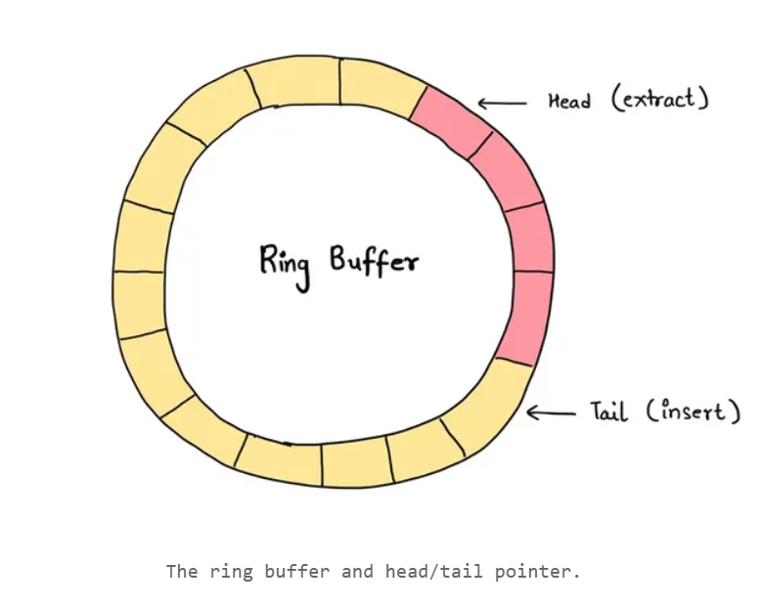
Ring Buffer Visualization
Source: Taken from [13].
Source: Taken from [38]
Notes:
(Explain how a Ring Buffer or Circular Buffer works.):
This is a visual diagram of the RingBuffer.
Head and Tail: There is a head and tail pointer where the head extracts the data and the tail inserts the data. The tail will insert the data while the head reads the data. The first diagram on the left is a static representation of the RingBuffer Concept. Because the head always reads the oldest element and the tail always writes the newest, the order of removal matches the order of insertion → FIFO.
Read and Write: Another way to look at this is through read and write pointers where one pointer will write the data in through each circle and the read pointer will read out the data written. The read pointer always advances behind the write pointer, so the first written element is the first read

Slide 12
Main Contributions
Design and implement a Ring Buffer-based SNN (RingSNNs) pipeline tailored for regression-style time-series forecasting, enabling efficient temporal encoding and continuous prediction.
Propose a reproducible benchmarking methodology for jointly evaluating predictive accuracy and energy consumption in SNNs, enabling comparison between neuromorphic hardware (Loihi 2) and conventional GPU platforms.
Introduce an energy measurement protocol that accounts for the addition of idle, active, and spike-driven power states to ensure fair and reproducible comparisons between Loihi 2 and GPU implementations.
Establish that Ring Buffer SNNs are a viable solution for real-time forecasting in energy-constrained environments like IoT and edge devices by combining biologically inspired temporal memory with hardware-specific evaluation
Notes:
The main contributions of our work are (Read off and elaborate on Main Contributions.) Mention that from now on, RingBuffer-based SNN will be referred to as RingSNN. Also mention end-to-end processing flow or pipeline
(Items to know but NOT say except when asked):
Efficient temporal encoding means the model captures short‑term temporal patterns using sparse, event‑driven spikes instead of dense, time‑driven computation.
Edge devices are small, local computing devices that sit close to where data is generated—like sensors, meters, cameras, or wearables—and process data directly on‑site instead of sending everything to the cloud.
The Internet of Things (IoT) is a network of everyday physical devices—like sensors, meters, appliances, and wearables—that collect data and connect to each other or to the internet.
Loihi 2 was used because it provides the decomposed power states, flexibility, and measurement precision required for this work — capabilities that Loihi 1 does not support

Slide 13
RingSNN Approach
Have control over inputs and spike fluctuations in SNN hardware implementation
Help maintain biologically inspired short-term memory of recent spike histories while simultaneously smoothing event-driven spike trains into real-valued outputs suitable for regression tasks
Ring Buffer SNNs achieve efficient temporal representation through sparse, event-driven updates
Design aligns with neuromorphic principles of energy-efficient computation and supports real-time forecasting in streaming environments where low latency and reduced power consumption are critical
Work is focused on energy benchmarking and reproducibility
Notes:
Now going over the rationale behind the RingBuffer in the SNN Architecture. (Read off and elaborate RingSNN Approach.)
(2nd Bullet Pt.): Mention “it helps the network to capture temporal dependencies essential for continuous-valued predictions” after “Help maintain biologically inspired short-term memory of recent spike histories” (“streaming environments where low latency and reduced power consumption are critical” in the context refers to scenarios where data arrives continuously, decisions must be made immediately, hardware resources (power, memory, compute) are limited”)
(3rd Bullet Pt.): In contrast to conventional deep learning models, which often rely on hidden states with high computational and memory demands. In RingSNN, efficient temporal representation arises because the Ring Buffer maintains short‑term history along with event-driven spike trains into numeric values (Temporal dependencies refer to relationships in data that unfold over time—where the current value depends on past values.)
(5th Bullet Pt.): Work is focused on energy benchmarking and reproducibility, RingBuffer SNN is a great candidate for energy profiling and benchmarking utility,

Slide 14
Datasets
National Renewable Energy Laboratory (NREL) solar generation profile (Solar Production) [15]
PJM Interconnection LLC (PJM) Hourly Energy Consumption [16]
Solar Influences Data Analysis Center (SIDC) Monthly Mean Total Sunspot Number datasets [17]
All datasets perform the following
Normalized prior to training and are divided into training (first 80% rows) and testing sets (last 20% rows)
After compiling, training, testing, and evaluating the models, data is denormalized using Inverse Transform back to its original form.
Notes:
These are the three datasets used for the RingSNN and ANN baseline comparisons (Solar Production, AEP Hourly Energy Consumption, and Sunspot). (Read last bullet pt.)

Slide 15
NREL Solar generation profile (Solar Production)
The datasets are provided for four U.S. Independent System Operator territories: ERCOT, NYISO, MISO, and SPP
ERCOT solar production data (5-minute resolution, 2017) was used
Input Feature: time_index represents the time stamp
Target Variable: solar production gathered in megawatts (MW) or kilowatt hours (kWh)
Both actual and forecasted data have high temporal and spatial fidelity and the forecasted data includes both deterministic and probabilistic forecasts
Clean time-series format with no need for complex preprocessing and fits well with ANN and RingSNN models
Consistent sampling with uniform time intervals making the dataset easier to batch, normalize, and encode
Realistic solar generation patterns are captured including variability and ramp events and are useful for benchmarking energy vs. accuracy tradeoffs in neuromorphic vs. conventional models.
Notes:
(Read from Solar Production Slides starting from 4th bullet.)
High Temporal Fidelity means the data captures changes very precisely over time.
High Spatial Fidelity refers to how detailed the data is across space, not time.
ramp event is a period where a signal changes rapidly and consistently over a short time window — either increasing or decreasing.

Slide 16
PJM Hourly Energy Consumption (AEP)
Provides estimated energy consumption for every hour from 2004-2018
Input Feature: Datetime
Target Variable: American Energy Power Megawatts (AEP_MW)
Known for its hourly energy consumption measurements providing sufficient temporal granularity to model short-term demand variability as well as long-term seasonal trends
This pattern makes the dataset one of the best candidates for benchmarking purposes due to its connection to grid reliability, energy pricing, and sustainability planning.
The presence of weather-driven, seasonal, and behavior-dependent patterns makes the dataset suitable for evaluating forecasting models
Notes:
(Read from PJM Hourly Energy Consumption starting from 4th bullet pt.)

Slide 17
SIDC Monthly Mean Total Sunspot Number (Sunspot)
Mean or average of the daily total sunspot number of all days at the end of each calendar month from 1749 – 2021
Input feature: Date; target variable: Monthly Mean Total Sunspot Number [17]
Dataset is particularly valuable due to its extensive historical coverage
Sunspot activity correlates with solar radiation and space weather, which in turn affects climate, satellite operations, and energy production [32]
Notes:
(Read from SIDC Monthly Mean Total Sunspot Number starting from 3rd bullet pt. Then mention the following)
The sunspot dataset covers a good cross-section of temporal behaviors within its domain.

Slide 18
SNN and ANN architectures
Convolutional Neural Networks (CNN)
Long Short-Term Memory (LSTM) and Gated Recurrent Units (GRU)
Class of Recurrent Neural Networks (RNNs)
RNN: uses previous information to produce current output
LSTM: special type of RNN with additional features to memorize the sequence of data.
GRU: Designed to model sequential data by allowing information to be selectively remembered or forgotten over time with fewer parameters than LSTM
Hybrid CNN-LSTM
RingSNN Architecture
RingSNN vs ANN Architectures
Notes:
For our work, we have designed and implemented the following ANN and SNN models for time-series forecasting and prediction.
(In 2nd Bullet Sub-Bullet, read slides and mention the following):
The architectures will not be shown as it’s similar structurally to the CNN architecture but their results will be posted. The LSTM and GRU are a class of Recurrent Neural Networks (RNNs)
RNN (Recurrent Neural Network): designed to work with Sequential Data like Time-Series; uses previous information to produce current output; can store the relationship between the current input of the neuron and the output of the previous time.
LSTM (Long Short-Term Memory): special type of RNN with additional features to memorize the sequence of data. Each LSTM is a set of cells, or system modules, where the data streams are captured and stored. Due to the use of some gates in each cell, data in each cell can be disposed of, filtered, or added for the next cells. The hidden state is the LSTM’s distilled representation of the timestep window after it has processed all timesteps (Input to LSTM: a sequence of length T/2 with F features, Output of LSTM: a vector of length H, That H dimensional vector is the hidden state)
Hidden state in deep learning is a vector representation with RNNs that acts as the model's memory, capturing temporal dependencies and past information in sequence data to allow networks to understand context over time
GRU (Gated Recurrent Unit): designed to model sequential data by allowing information to be selectively remembered or forgotten over time with fewer parameters than LSTM, which can make it easier to train
GRU’s lightweight gating means it uses fewer gates and simpler computations than an LSTM, making it faster and more efficient while still capturing temporal patterns

Slide 19
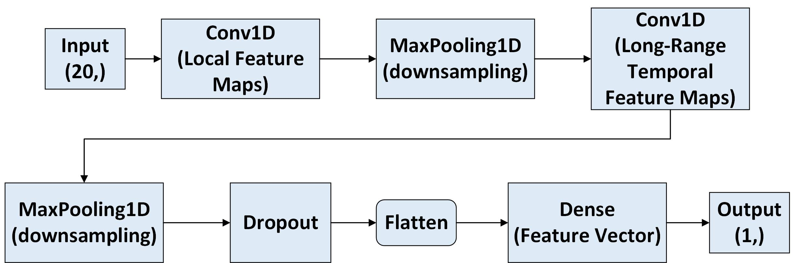
CNN Architecture
Notes:
The CNN model begins by applying a sliding window over the time‑series, which preserves temporal ordering and lets the network analyze short segments of the signal. This is important because forecasting depends on understanding how recent values influence the next one. The first Conv1D layer extracts short-range local temporal features. It slides a small kernel across the input window and detects short‑range patterns such as ramps, spikes, or small fluctuations. The 1D-CNN layer works well for univariate time‑series because the important structure is often local. An activation function (ReLU) adds nonlinearity, allowing the model to learn more expressive features. This is followed by the MaxPooling1D which downsamples the feature maps, keeping only the strongest activations. This step reduces noise, highlights the most important short‑term events, and stabilizes the features for the next layers. This is followed by a second Conv1D + Activation + MaxPooling1D block learns higher‑level temporal patterns. A Dropout layer is added here to prevent overfitting. Flatten converts the pooled feature maps into a single static feature vector, removing the time dimension and preparing the representation for the final regression layer. Finally, a Dense layer maps this feature vector to a single numeric forecast. This layer performs the final linear transformation that produces the model’s output.
(Items to know but NOT say except when asked):
Sliding Window Mechanism: manages temporal data by analyzing a moving segment of input signals, rather than the entire sequence at once. It helps reduce computational complexity and helps with real-time processing.
Kernel is the small matrix of learnable weights
In 1D‑CNNs, temporal features are short‑range patterns such as slopes, transitions, and fluctuations.
My datasets contain peaks, valleys, transitions, bursts, curvature, chaotic fluctuations.
Nonlinearity is the ability to detect patterns that are not straight‑line relationships
ReLU preserves positive changes and suppresses weak (noisy), negative, downward movements in the time-series. It works best because it preserves temporal variation, avoids saturation, maintains strong gradients, produces sparse activations, and mirrors LIF thresholding—while tanh and sigmoid compress, saturate, and distort the temporal features
Temporal resolution is the information that comes directly from datasets using downsampling
MaxPooling1D is used because the datasets are 1‑dimensional time‑series, so pooling must occur along the temporal axis; MaxPooling2D and MaxPooling3D require spatial or volumetric data and would be structurally incompatible with univariate time‑series.
The static feature vector is the fixed‑length, time‑independent representation produced by flattening the Conv1D feature maps, summarizing all learned temporal patterns.

Slide 20
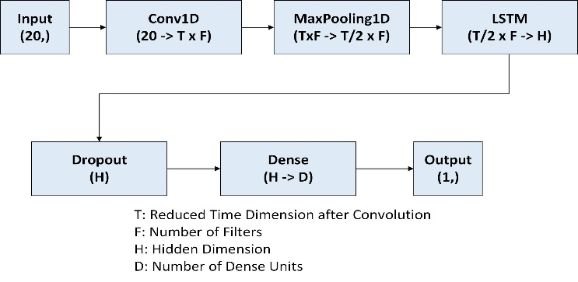
Hybrid CNN-LSTM
Notes:
For our work, I also implemented a CNN-LSTM model to find out whether the hybrid approach gives a better performance. The rationale behind this is that CNN-LSTMs have demonstrated good performance in various applications involving both spatial and temporal data. The goal of the hybrid approach is to excel at learning hierarchical spatial features using CNN and long-term temporal dependencies using LSTM. The input sequence first passes through a 1D convolution layer that extracts short‑range temporal patterns, followed by max‑pooling to reduce noise and compress the time dimension. The pooled features are then fed into an LSTM layer, which captures longer‑term temporal dependencies across the window. The long‑term temporal dependencies through its hidden state and cell state, which carry learned information across all timesteps in the window. A dropout layer helps prevent overfitting, and a final dense layer maps the learned temporal representation to a single output value.
(Items to know but NOT say except when asked):
Spatial Features: the, multi-layered, bottom-up process where network layers learn increasingly complex visual patterns by combining simpler features from previous layers)

Slide 21
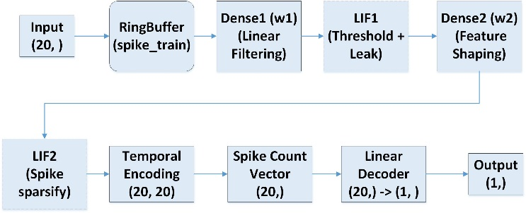
RingSNN Architecture
Notes:
The RingSNN model processes time‑series data using a sliding window. Each value in the window is first normalized and then converted into spikes using rate‑based probabilistic encoding. This creates a spike matrix, where neurons fire over timesteps. This happens between the Input and RingBuffer. The RingBuffer does not create spikes — it simply stores and replays these pre‑encoded spike trains. (Flip back to Slide 11). This gives the SNN a short‑term memory of recent activity and ensures the model always receives input in the correct time order. Dense1 and LIF1 form the first feature‑extraction stage. Dense1 applies a learned linear filter to the incoming spike trains, detecting short‑range temporal patterns. LIF1 applies thresholding and leak, which reduces unnecessary spikes and keeps only the important ones. Dense2 and LIF2 repeat this process by learning higher‑level temporal patterns. Dense2 combines the earlier features and learns more general patterns. LIF2 again filters the activity, keeping only the strongest temporal events. Next, the LIF2 spike output is expanded through a temporal‑encoding stage, where the LIF2 spikes are turned into a 20×20 grid that shows how the activity changes over a short time window. After Temporal Encoding, the model collapses time using a Spike Count Vector. This sums spikes across all timesteps, producing a static feature vector that summarizes the temporal activity of the entire window. Finally, a linear decoder maps the static feature vector to a single numeric forecast. This decoder is lightweight and interpretable, and its weight patterns reflect how well the upstream spike‑based features capture the underlying temporal structure.
(Items to know but NOT say except when asked):
Population coding expands each input into multiple neurons; rate encoding converts each of those neurons into spike trains based on firing probability.
Rate‑based probabilistic encoding converts each normalized input value into a spike train by sampling spikes with probability proportional to the value’s magnitude.
Temporal Encoding: way of turning changes over time into a form the model can understand.
Linear filtering in Dense1 refers to the purely linear weighted summation of spike inputs, analogous to the linear part of a Conv1D layer, which extracts low‑level temporal features before the LIF neuron applies nonlinear thresholding.
The spike patterns produced by the earlier SNN layers (Dense1→LIF1 and Dense2→LIF2) before the decoder.
In the RingSNN, Dense1 + LIF1 extract the spike‑based equivalents of the short-range patterns (with AEP producing rich temporal features, Sunspot producing noisy but informative features, and Solar producing weak, sparse features due to its smooth dynamics.)).
The linear decoder is the function. The decoder weights are the parameters that the function uses.
Decoder Weights: learned parameters that determine how hidden representations are transformed back into human-readable, actionable output.

Slide 22
RingSNN vs ANN Architectures
Stage | CNN | RingSNN | Conceptual Role
Input | Sliding window Numeric input | RingBuffer (spike replay of rate‑encoded window) | Provides temporal context; Converts Window into a time‑unfolded sequence
Feature Extraction 1 | Conv1D + Activation | Dense1 + LIF1 (Ring 1) | Learns short‑term temporal features: linear filter + nonlinear activation
Downsampling/ Sparsification | MaxPooling1D | LIF1 thresholding (spike sparsification) | Removes weak activations; reduces temporal resolution; keeps salient features
Feature Extraction 2 | Conv1D + Activation | Dense2 + LIF2 (Ring 2) | Learns higher‑level temporal patterns; Multi‑Scale Feature Extraction
Flattening / Feature Vector | Flatten | Spike count vector (across simulation window) | Converts temporal activity into a static feature vector for regression
Final Regression Layer | Dense (regression) | Decoder (linear readout) | Maps learned features to final output value
Notes:
For comparison purposes, included a 1-1 mapping table between RingSNN and ANN comparison.
(Items to know but NOT say except when asked):
ANN Component -> SNN (LIF) Component -> Why
ReLU / tanh / sigmoid -> Threshold + reset -> Both introduce nonlinearity
MaxPooling1D -> Thresholding (spike/no spike) -> Both keep only strong activations
Temporal smoothing (Conv1D receptive field) -> Leak term -> Both smooth signals over time
Only CNN and CNN‑LSTM diagrams are included because they represent the two architectural components that RingSNN parallels: local feature extraction and temporal integration. LSTM‑only and GRU‑only diagrams are omitted for brevity, as their recurrent mechanisms are already captured within the CNN‑LSTM comparison. I compare CNN and RingSNN because they share the same stage‑by‑stage feature‑extraction pipeline, allowing a clean 1‑to‑1 mapping between operations—something not possible with LSTM, GRU, or CNN‑LSTM.

Slide 23
Evaluation
Metrics for evaluating RingSNN and ANN models in terms of Accuracy and Efficiency
Mean Absolute Error (MAE) and Root Mean Squared Error (RMSE)
Hebbian Updates
Decoder Weights
Spike Raster Plots
Spike Density per Neuron
Efficiency Ratio
Energy Measurement Protocol
Notes:
Let’s go over the evaluation metrics that will be used to compare the architectures. Because these are time-series datasets, The architectures are going to be evaluated for both accuracy and efficiency.

Slide 24

Mean Absolute Error (MAE) and Root Mean Squared Error (RMSE)
$$\text{MAE}=\frac{1}{M}\sum_{t=1}^{M}{\left|x_{t}−p_{t}\right|}$$
$$\text{RMSE}=\sqrt{\frac{1}{M}\sum_{t=1}^{M}{{\left(x_{t}−p_{t}\right)}^{2}}}$$
$M$: total number of samples in a predicted period
$x_{t}$: true value
$p_{t}$ : predicted value
Notes:
Mean Absolute Error (MAE) - measures the average magnitude of the absolute errors between the actual and predicted values, without considering the direction of the errors.
Root Mean Squared Error (RMSE) - measures the average magnitude of the squared errors between the actual and predicted values, and then takes the square root.
For MAE and RMSE, the model with the lowest values is selected. In time‑series forecasting, MAE and RMSE measure how far predictions deviate from the true values, so the model with the lowest values is the most accurate.

Slide 25
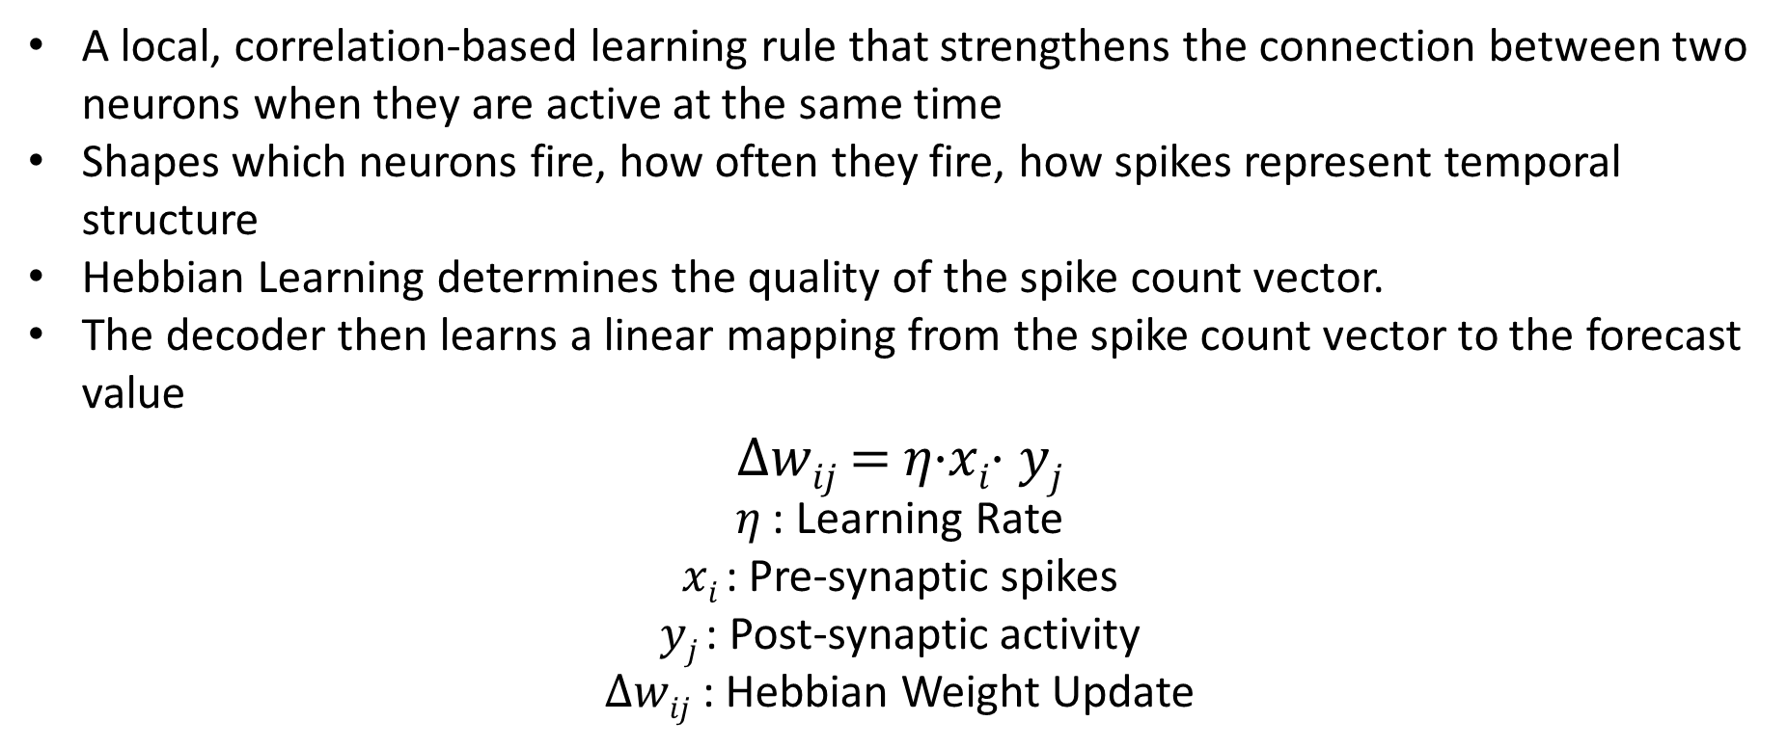
Hebbian Learning
A local, correlation‑based learning rule that strengthens the connection between two neurons when they are active at the same time
Shapes which neurons fire, how often they fire, how spikes represent temporal structure
Hebbian Learning determines the quality of the spike count vector.
The decoder then learns a linear mapping from the spike count vector to the forecast value
Δ𝑤_{𝑖𝑗} = 𝜂⋅𝑥_{𝑖}⋅ 𝑦_{𝑗}
𝜂 : Learning Rate
𝑥_{𝑖} : Pre‑synaptic spikes
𝑦_{𝑗} : Post‑synaptic activity
Δ𝑤_{𝑖𝑗} : Hebbian Weight Update
Notes:
Before explaining the concept of Decoder Weights, I need to explain Hebbian Learning from which the decoder learns to forecast.
(Between 3rd and 4th Bullets): Once Hebbian learning shapes the spike‑based representation, the decoder uses that representation to perform the final prediction.
(Between 4th and Equation): This is achieved using the following Hebbian weight update rule.
𝑥_{𝑖} = activity (spikes) from the pre‑synaptic neuron → the neuron sending the signal
𝑦_{𝑗} = activity of the post‑synaptic neuron → the neuron receiving the signal
𝜂 = learning rate → how fast the connection changes
Δ𝑤_{𝑖𝑗} = how much the weight between the two neurons changes
Hebbian learning in the RingSNN updates the weights of Dense1 and Dense2, using the presynaptic spikes entering each Dense layer and the postsynaptic spikes produced by the corresponding LIF neuron.
(Comparison with Gradient Descent)
(Hebbian learning describes how synaptic strengths are adjusted based on the correlation of pre‑and post‑synaptic activity, providing a biologically plausible mechanism for learning in SNNs. They utilize Hebbian updates where weights are updated based on spike activity across epochs. Involves synaptic connections between the spikes based on correlated groups of synapses [32]. As a result, Hebbian weights are computationally lightweight, requiring no backpropagation or gradient tracking, and can be more energy-efficient by avoiding complex calculations.)
(Flow: Hebbian learning → spike‑based latent space → decoder learning)

Slide 26
Decoder Weights
Learned parameters that determine how hidden representations are transformed back into human-readable, actionable output
SNN produces spikes while decoder transforms those spikes into a forecasted value and a numeric prediction
The decoder is the bridge between spike‑based latent space and human‑interpretable output
Decoder Weight Evolution Plots useful for finding out the learning trajectory by observing whether the weights converge, oscillate, or diverge
Decoder weight plots are the SNN equivalent of showing ANN feature importance
Diagnose how well Hebbian learning worked
Notes:
Another visual representation of the evaluation of the models was for decoder weight plots. (Read off bullets; then mention the following).
(1st Bullet Pt. if asked): The hidden representations are the internal spike‑based features RingSNN produces before the decoder (the 20‑dimensional spike‑count vector)
(4th Bullet Pt.): Converge = weights settle, Oscillate = weights wiggle, Diverge = weights fail to stabilize.
(5th Bullet Pt.): Decoder weight evolution plots serve as an evaluation tool for assessing learning stability, representation quality, and decoder alignment throughout training
(6th Bullet Pt.): Hebbian learning shapes the internal spike‑based representation, and the decoder weights reflect how well that representation captures the underlying temporal structure needed for forecasting.
(The linear decoder is the linear regression function which uses decoder weights as the parameters to produce the forecast. It’s the mathematical operation that maps spike counts to the final output.
$\hat{y}$=w⊤x+b where it takes the spike‑count vector $x$
Multiplies it by the decoder weights $w$
Adds a bias $b$
Produces the final output $\hat{y}$)
(Latent Space: The 20‑dimensional spike‑count feature vector that summarizes the temporal structure of the input window. Analogous to: the Flatten layer output in CNN, the LSTM hidden state in CNN‑LSTM. It’s the compressed, information‑rich representation of the input.)

Slide 27
Spike Raster Plots
Visualization that shows when each neuron fires over time
Provide insight into the sparsity, stability, and structure of the spike‑based representations generated by the RingBuffer and the Dense–LIF connections
Plots are useful for visualizing how neurons respond to input over time and complements the energy profiling graphs by showing when computation is triggered
Plots serve as an essential diagnostic tool to verify that the encoder produces appropriate spike rates, that the LIF neurons operate within a stable firing regime, and that the network develops meaningful temporal features
Notes:
(Encoder: encoder in neural networks is a functional component responsible for transforming input data into a compressed, high-level, numerical representation, Data -> Numbers)
(Last Bullet Pt): “LIF neurons operate within a stable firing regime” means the neurons fire in a balanced, controlled, and consistent way—neither too much nor too little—and the spike raster plots visually confirm that the SNN is encoding the input signal properly rather than behaving chaotically or collapsing.

Slide 28
Spike Density Per Neuron
Show frequency of spikes at different spike counts
Reveal which neurons are more active, helping assess sparsity and load balancing
Verify that the Dense–LIF connections are not producing dead neurons or overly dominant neurons, which is important for stable Hebbian learning
Valuable for energy analysis, since neurons with higher spike counts contribute more to synaptic, routing, and memory‑access energy
Notes:
A representation is sparse when a small subset of neurons fire spikes occur infrequently most neurons are silent at most timesteps
(A well‑balanced SNN has:
no “dead neurons” (never fire)
no “dominant neurons” (fire excessively)
a healthy distribution of spike counts across the population -> fair workload distribution)

Slide 29
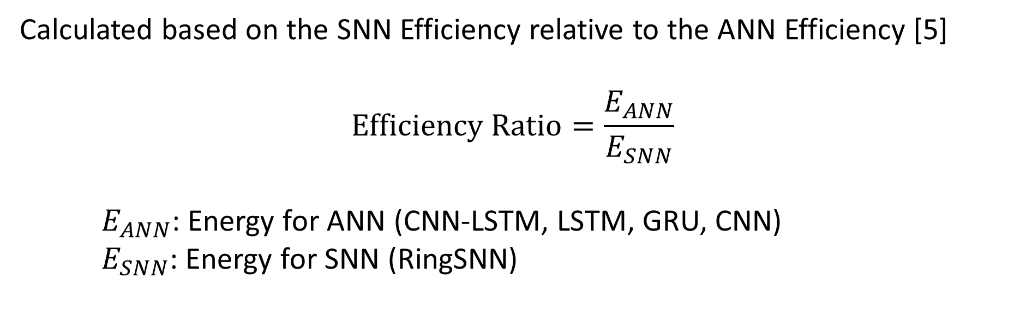
Efficiency Ratio
Calculated based on the SNN Efficiency relative to the ANN Efficiency [5]
$$\text{Efficiency} \text{Ratio}=\frac{E_{ANN}}{E_{SNN}}$$
$E_{ANN}$: Energy for ANN (CNN-LSTM, LSTM, GRU, CNN)
$E_{SNN}$: Energy for SNN (RingSNN)
Notes:
To compare how much energy each model uses, we compute an efficiency ratio between the ANN and the RingSNN. The Energy Efficiency of SNN relative to ANN is calculated according to the Efficiency Ratio. Efficiency ratios are used in tradeoff analysis because it gives a universal comparison, and shows the relative advantages of neuromorphic hardware. Furthermore, ratio quantifies the sustainability benefit of SNNs in a way that is hardware‑aware, reproducible, and easy to interpret.
(Items to know but NOT say except when asked):
Because RingSNN requires an update at each timestep, there is a need for consideration of the network topology and temporal resolution.
RingSNN updates at every timestep because its neurons change from moment to moment, so the model has to check their state continuously.
ANNs do not require updates at every moment — they only update when new data is fed
(Network topology is the way the neurons or layers in a model are arranged and connected to each other.)

Slide 30
Energy Measurement Protocol
Idle Power State: baseline power consumption when the hardware is powered on but performs no computation or spike activity
Active state: how much power is consumed during general runtime operations like memory access, routing, or scheduling independent of spike events
Spike-driven power state: capture event-driven spike activity (e.g. neurons firing, synaptic updates, spike routing)
For ANNs: idle + active power consumption
Measured with Nvidia-SMI, since GPU remains under load during inference and does not support state decomposition
RingSNNs: Idle + Active + Spike‑Driven power states (These power states are converted into idle, active, and spike‑driven energy by multiplying by runtime)
Total energy consumption for all models is divided by the number of test samples to compute energy per sample (µJ/sample), accounting for differences in network topology and temporal resolution between ANN and RingSNN.
Notes:
An energy measurement protocol is implemented to separate or decompose idle, active, and spike‑driven power states to ensure fair and reproducible benchmarking across neuromorphic and conventional platforms. This energy decomposition provides fine‑grained, reproducible energy vs. accuracy benchmarking showing where energy is consumed and its usage. (Read off bullet pts and elaborate on the following)
For Idle Power State: Mention Static Leakage Currents, background systems
For Active State: Mention the overhead of keeping the system engaged, the ability to process inputs, and includes control logic, clock cycles, and communication costs
For Spike Driven Power State: This shows that energy scales with spike rate and sparsity making them a unique neuromorphic phenomenon
The spike-driven power states investigate how efficient SNN is at converting spikes into useful computation
In RingSNNs, decomposed energy states are derived from Loihi’s Idle, Active, and Spike‑Driven power states
These three power states correspond directly to the decomposed energy terms defined in the qualifying‑exam problem: Loihi exposes idle, active, and spike‑driven power separately, while the GPU provides only a combined idle+active power draw through Nvidia‑SMI.

Slide 31
Results
Show the results of testing the RingSNN model with the time-series datasets along with comparisons to their ANN counterparts and other architectures
Efficiency Ratio, Energy, MAE, and RMSE
Prediction vs Ground Truth Plots for RingSNN and ANN
Energy vs MAE Tradeoff Across Models (With Efficiency Ratios)
Decoder Weights
Spike Raster Plots
Spike Density per Neuron
Efficiency Ratio
Energy States
Notes:
These next set of slides will show (first bullet pt). I will show the (read sub-bullets elaborating on the following.)
Efficiency Ratio, Energy, MAE, and RMSE tables, graphs, and runtimes per epoch, spike counts, accuracy metrics, and decomposed energy states (idle, active, spike-driven for Loihi; power-draw logs from Nvidia-SMI for the GPU)
I’ll also present Energy profile of the normalized energy consumption per sample and the energy-accuracy tradeoff plot and finally go over whether the neuromorphic hardware offers a practical advantage for sustainability-focused forecasting tasks.
I will also discuss limitations, hardware bottlenecks, and scenarios where SNNs may or may not be preferable.

Slide 32
Efficiency Ratio, Energy, MAE, and RMSE
For all three datasets — Solar Production, AEP Hourly Consumption, and Monthly Sunspot—runtime behavior of the models remained consistent
The Loihi‑style RingSNN achieved average epoch runtimes of 12–15 ms, reflecting the efficiency of event‑driven execution and lightweight neuron updates
GPU‑based ANN baselines completed each epoch in 3–5 ms, benefiting from highly parallel dense‑tensor operations and optimized CUDA kernels
These runtime measurements were stable across datasets and directly complement the energy and accuracy results fulfilling the requirement to report logged runtime per epoch as part of the benchmarking protocol
By recording per‑epoch runtime, spike counts, and accuracy, we construct energy–accuracy trade‑off curves to evaluate the practical efficiency of neuromorphic computing in sustainability-oriented forecasting tasks
Notes:
(Read bullet pts and mention the following).
(1st Bullet Pt.): Mention Looking at the datasets then read first bullet pt.
(3rd Bullet Pt.): Note that the GPU remains under load during inference and does not expose separate idle, active, or spike‑driven power states.
(Don’t mention unless otherwise asked)
Dense tensor operations: large, continuous matrix–vector or matrix–matrix multiplications that GPUs and CPUs perform during ANN training and inference.
Optimized Cuda Kernels: GPU routines that have been carefully tuned to run as fast and efficiently as possible by maximizing parallelism, minimizing memory bottlenecks, and fully utilizing GPU hardware.

Slide 33
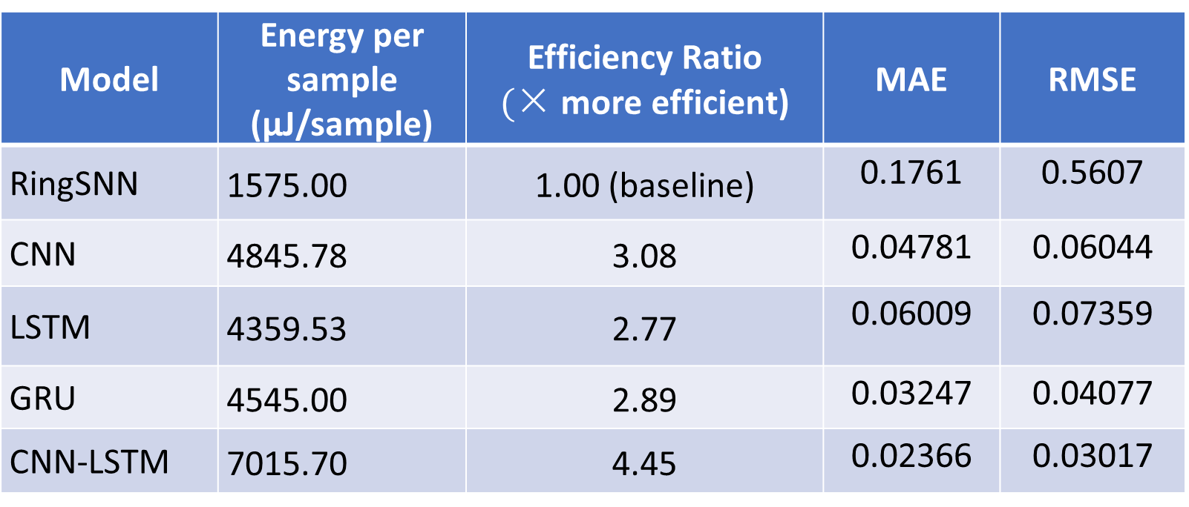
Efficiency Ratio, Energy, MAE, and RMSE
AEP Hourly Energy Consumption Dataset
Model | Energy per sample (µJ/sample) | Efficiency Ratio $($× more efficient) | MAE | RMSE
RingSNN | 1575.00 | 1.00 (baseline) | 0.1761 | 0.5607
CNN | 4845.78 | 3.08 | 0.04781 | 0.06044
LSTM | 4359.53 | 2.77 | 0.06009 | 0.07359
GRU | 4545.00 | 2.89 | 0.03247 | 0.04077
CNN-LSTM | 7015.70 | 4.45 | 0.02366 | 0.03017
Notes:
The following set of slides present the Efficiency Ratio, Energy, and RMSE tables, graphs and interpretation. This is to show how much more efficient each ANN is relative to the RingSNN. Amongst the ANNs, CNN and GRU provide the next best efficiency depending on the dataset while CNN-LSTM consumes more energy across datasets. The better efficiencies vary due to AEP containing high‑frequency, sporadic, human‑driven noise that benefits from GRU’s lightweight gating and temporal smoothing. On the other hand, the Solar Production and Sunspot datasets contain smoother, short‑range temporal patterns, which Conv1D captures efficiently with lower computational cost, making CNN the second‑most efficient model for those datasets.

Slide 34
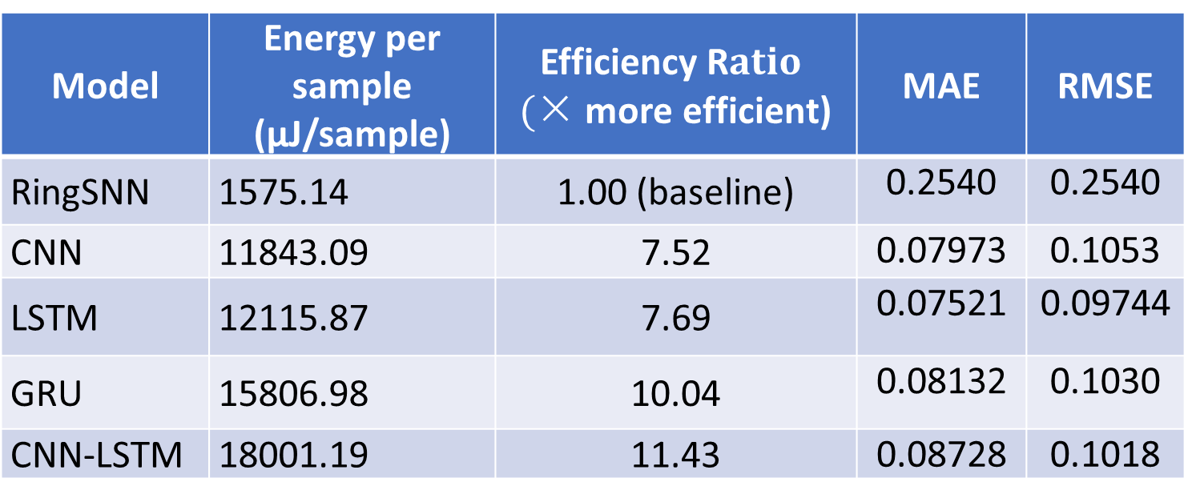
Efficiency Ratio, Energy, MAE, and RMSE
Monthly Sunspot Dataset
Model | Energy per sample (µJ/sample) | Efficiency R$atio$ $($× more efficient) | MAE | RMSE
RingSNN | 1575.14 | 1.00 (baseline) | 0.2540 | 0.2540
CNN | 11843.09 | 7.52 | 0.07973 | 0.1053
LSTM | 12115.87 | 7.69 | 0.07521 | 0.09744
GRU | 15806.98 | 10.04 | 0.08132 | 0.1030
CNN-LSTM | 18001.19 | 11.43 | 0.08728 | 0.1018
Notes:
Shows how much more efficient each ANN is relative to the RingSNN. For all three datasets, RingSNN stands out as the most energy-efficient model, but with accuracies closer to ANN models. Amongst the ANNs, CNN and GRU provide the next best efficiency depending on the dataset while CNN-LSTM consumes more energy across datasets. The better efficiencies vary due to AEP containing high‑frequency, sporadic, human‑driven noise that benefits from GRU’s lightweight gating and temporal smoothing. On the other hand, the Solar Production and Sunspot datasets contain smoother, short‑range temporal patterns, which Conv1D captures efficiently with lower computational cost, making CNN the second‑most efficient model for those datasets.

Slide 35
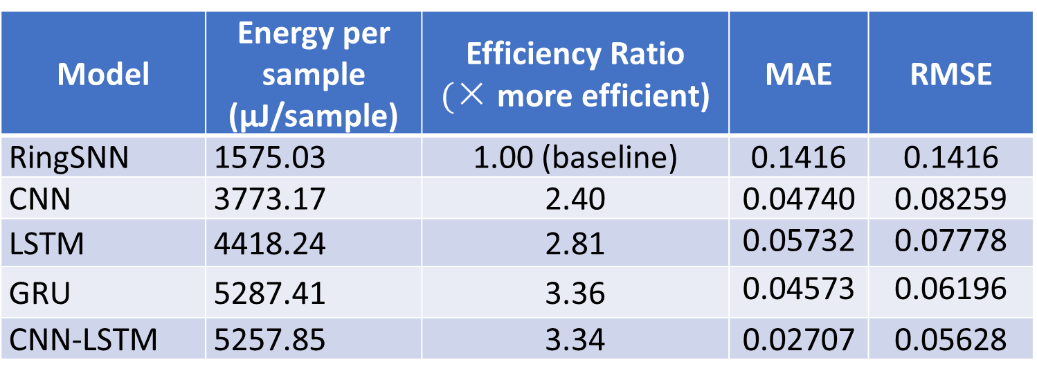
Efficiency Ratio, Energy, MAE, and RMSE
Solar Production Dataset
Model | Energy per sample (µJ/sample) | Efficiency Ratio $($× more efficient) | MAE | RMSE
RingSNN | 1575.03 | 1.00 (baseline) | 0.1416 | 0.1416
CNN | 3773.17 | 2.40 | 0.04740 | 0.08259
LSTM | 4418.24 | 2.81 | 0.05732 | 0.07778
GRU | 5287.41 | 3.36 | 0.04573 | 0.06196
CNN-LSTM | 5257.85 | 3.34 | 0.02707 | 0.05628
Notes:
Shows how much more efficient each ANN is relative to the RingSNN. For all three datasets, RingSNN stands out as the most energy-efficient model, but with accuracies closer to ANN models. Amongst the ANNs, CNN and GRU provide the next best efficiency depending on the dataset while CNN-LSTM consumes more energy across datasets. The better efficiencies vary due to AEP containing high‑frequency, sporadic, human‑driven noise that benefits from GRU’s lightweight gating and temporal smoothing. On the other hand, the Solar Production and Sunspot datasets contain smoother, short‑range temporal patterns, which Conv1D captures efficiently with lower computational cost, making CNN the second‑most efficient model for those datasets.

Slide 36
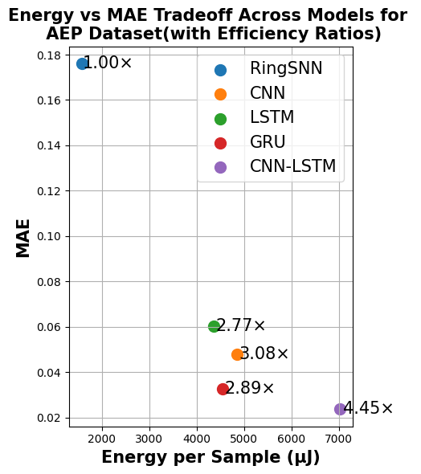
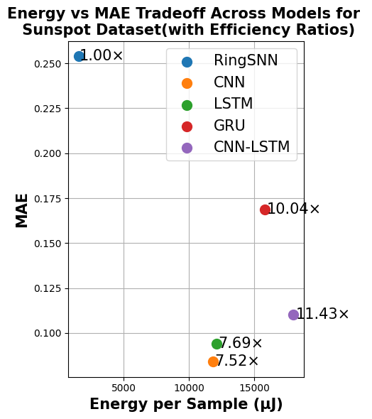
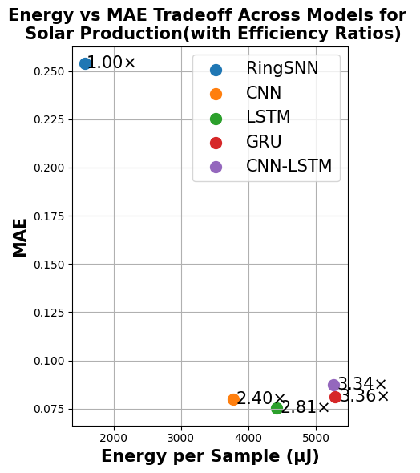
Energy vs MAE Tradeoff Across Models (With Efficiency Ratios)
Notes:
Here are the Energy vs MAE Tradeoff Plots with Efficiency Ratios. This is a visual representation of the tables from the datasets.

Slide 37
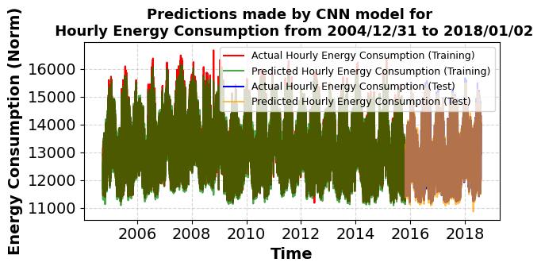
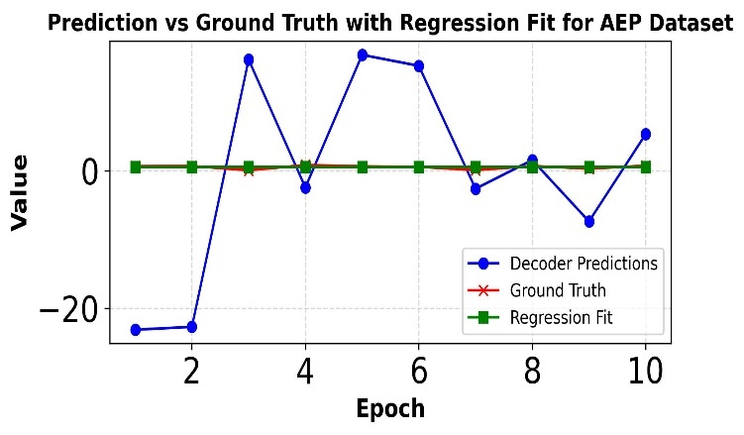
Prediction vs Ground Truth Plots for RingSNN and ANN
Notes:
Here are the Prediction vs Ground Truth Plots for the RingSNN and ANN for all three datasets. I’m only going to show the prediction vs ground truth plots for the CNN. You can see how closely matched the Actual and Predicted values are. The RingSNN shows that the decoder predictions are somewhat unstable due to spike-driven variability, while ground truth remains stable. A regression-fit feature vector is included alongside spike-derived features as it encodes spike counts per epoch. The regression fit plot is helpful in visualizing energy vs. accuracy tradeoffs and helps explain decoder deficiency and closely match the ground truths making it a good decoder alignment for the ANN baselines. They demonstrate that spike activity encodes predictive information, as the regression line aligns closely with the ground truth. This analysis confirms that RingSNN spike representations are predictive of target values. Although the direct decoder outputs exhibit significant variability, fitting a linear regression to spike activity demonstrates that RingSNN remains predictive. (flip to Slides 38 and 39 and come back to 38).
(Items to know but NOT say except when asked):
(Prediction vs Ground Truth plots assess how well the model tracks the real temporal signal. They visually show whether the model captures peaks, transitions, and overall shape.)
(Spike‑driven variability refers to the natural jitter in SNN outputs caused by discrete spike timing and spike count fluctuations.)

Slide 38
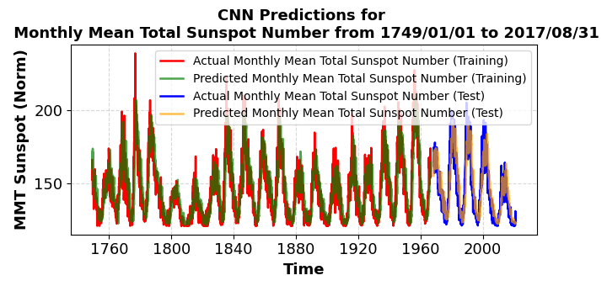
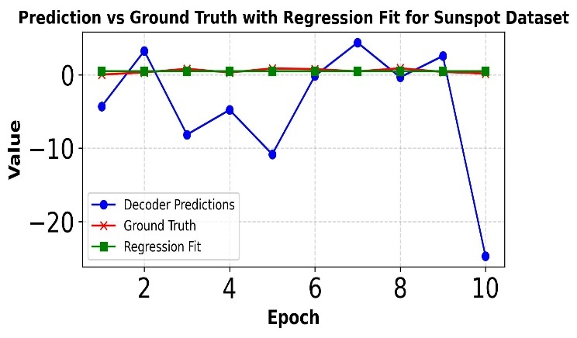
Prediction vs Ground Truth Plots for RingSNN and ANN
Notes:
The same is true for the Sunspot Dataset with the CNN and RingSNN. You might notice that the CNN Prediction vs Ground Truth plot looks different due to Sunspot dataset being chaotic and irregular, making it harder for the CNN to learn stable temporal patterns (oscillation curves, lags). This leads to noisier, less accurate predictions compared to AEP and Solar.

Slide 39
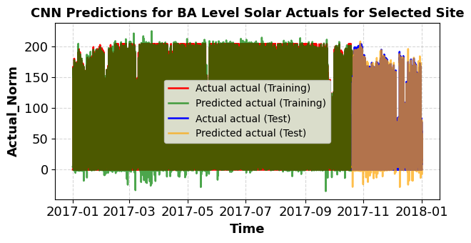
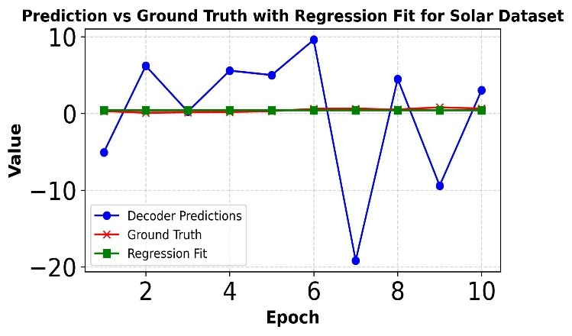
Prediction vs Ground Truth Plots for RingSNN and ANN
Notes:
And for the Solar Production Dataset.

Slide 40
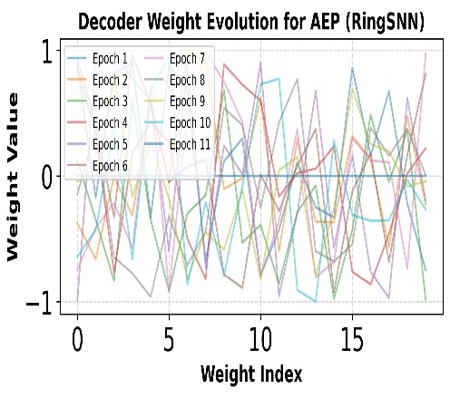
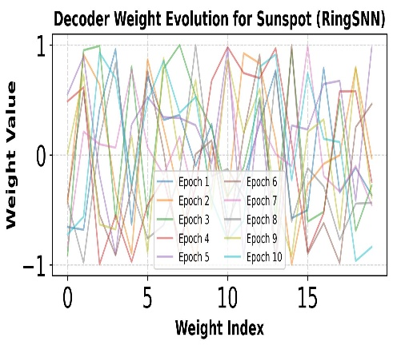
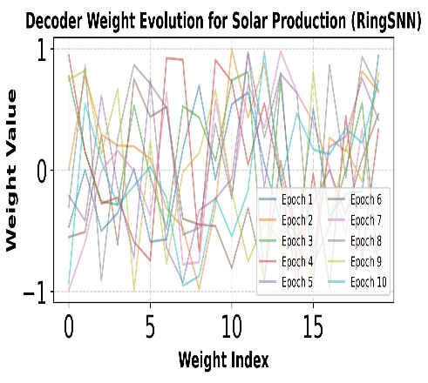
Decoder Weights
Notes:
And here are the Decoder Weight evolution graphs for each (AEP, Sunspot, and Solar Production) datasets. AEP shows clean convergence because the dataset has strong temporal structure and the SNN receives enough informative spikes to learn stable decoder weights. Sunspot weights oscillate because the data is chaotic. The SNN receives dense but inconsistent spike activity, so the decoder keeps readjusting instead of settling. (Solar weights look stable, but it’s not true convergence — the spike activity is so sparse that the decoder doesn’t have enough information to learn meaningful patterns.)

Slide 41
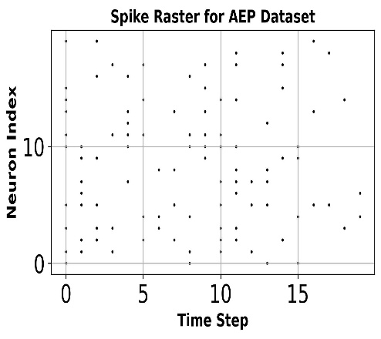
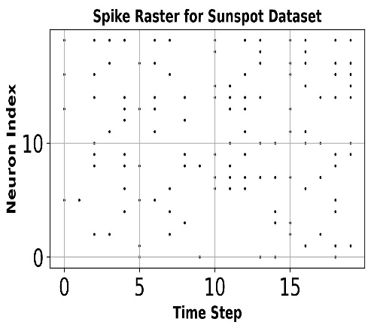
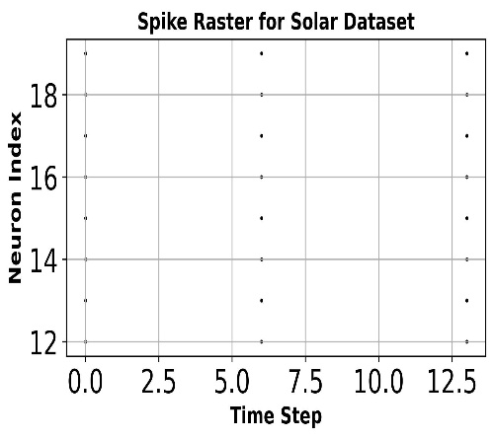
Spike Raster Plots
Notes:
(Remember x‑axis: time (simulation steps-20 timesteps in my case), y‑axis: neuron index-20 neurons, dot/mark: a spike event at that time for that neuron, Each row corresponds to one neuron, and each dot represents a spike.) Overall, the Spike Raster Plots show a uniform set of spikes for different time steps or run times at different neuron indices. AEP produces structured moderate activity, Sunspot produces dense chaotic spikes, and Solar produces extremely sparse spikes—revealing how each dataset drives different temporal representations inside the SNN. The Solar Production Raster Plot generates far fewer spikes because its signal is smooth, with flat periods during nighttime and gradual, predictable slopes during sunrise and sunset. In the RingBuffer encoder, spike generation is driven by changes in normalized magnitude and slope; when the input varies only minimally across consecutive time steps, the firing probability remains low and the resulting spike trains become extremely sparse. While this sparsity leads to very low energy consumption, it also limits the richness of the encoded representation and weakens decoder alignment.
(Spike generation is driven by changes in normalized magnitude and slope because SNNs are event‑driven systems: spikes should represent meaningful changes in the signal, not static values. This improves energy efficiency, but it also ensures that spikes represent meaningful temporal information, mirroring biological sensory coding.)

Slide 42
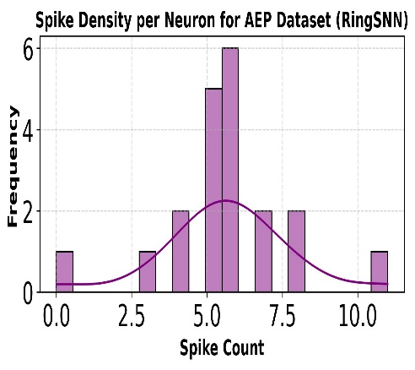
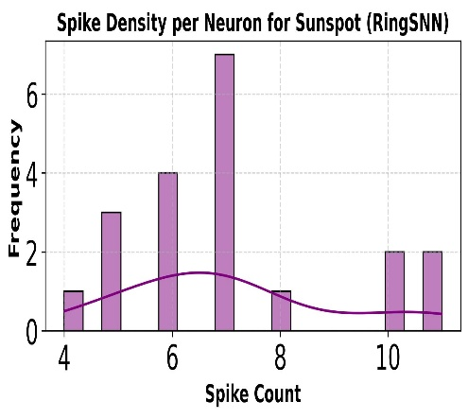
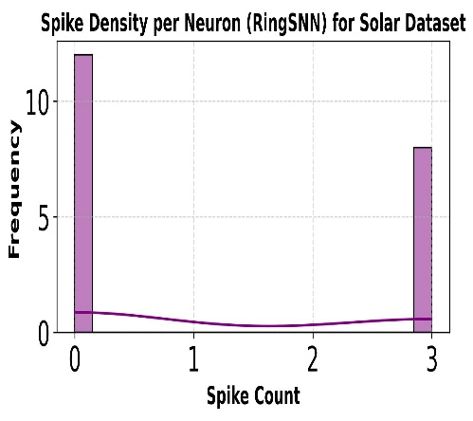
Spike Density per Neuron
Notes:
This is the Spike Density per Neuron Plot. It is a uniform distribution of spikes with five to seven spike counts being the most frequently emitted (referring to AEP and Sunspot Datasets). The Spike Density plot for the Solar Production Dataset sees spike count ranges from none to 3 due to the lower sparsity while the AEP has the best spike density and is the most balanced.

Slide 43
Energy States
RingSNN Idle, Active, and Spike-Driven Energy Decomposition for AEP, Sunspot, and Solar Production Datasets
Dataset | Total Energy Consumption (J) | Idle Energy (J = idle power × runtime) | Active Energy (Memory + Routing Energy in J) | Spike-Driven Energy (J per spike)
AEP | 7.501 × 10⁻⁴ | 7.5 × 10⁻⁴ | 1.1817x 10⁻⁷ | 2.691 x 10⁻⁹
Sunspot | 7.501 × 10⁻⁴ | 7.5 × 10⁻⁴ | 1.3736 × 10⁻⁷ | 3.128 × 10⁻⁹
Solar Production | 7.501× 10⁻⁴ | 7.5 × 10⁻⁴ | 6.565× 10⁻⁸ | 1.495 × 10⁻⁹
Notes:
Here is the decomposition of the energy states for the RingSNN model for all datasets with Idle, Active, and Spike Driven energy states. The spike-related component corresponds specifically to event-driven neural firing. You can see that idle energy remains constant across all evaluated datasets. However, noticeable variations appear in the spike-dependent energy. The Sunspot dataset exhibits higher spike-related energy consumption while the Solar Production dataset is the lowest. As I discussed with the Spike Raster Plots, this is due to the fewer spikes produced for Solar Production. The sparsity reduces energy usage and limits the expressiveness of the encoded signal and affect decoder performance. On the other hand, the Sunspot dataset produces increased spike-driven energy consumption due to the more frequent and varied spikes and higher temporal variability. As I mentioned before, the active energy component accounts for general processing tasks like memory operations and data routing. You can also see that with a higher spike-driven energy also come with a high active energy due to memory-access and routing energy associated with synaptic fan-out.
(Data routing is the process of moving information from one place in the hardware to another using a predefined map of where that information needs to go.)

Slide 44
Energy States
ANN Baseline Power Consumption Measured in Watts (W).
ANN Baseline | AEP | Sunspot | Solar Production
CNN | 2935.75 | 187.5 | 1981.25
LSTM | 2641.25 | 191.5 | 2320
GRU | 2753.5 | 250 | 2776.5
CNN-LSTM | 4250.5 | 284.75 | 2760.75
Notes:
Here is the decomposition of the energy states for the ANN Baseline Power Consumption. I mentioned before that GPU‑based ANN baselines completed each epoch in 3–5 milliseconds (ms). When operated for 10 epochs, this would take between 30-50 ms. Taking the average of this would mean 40 ms to complete the training. After finding the total GPU energy for the ANNs, it was divided by 40 ms to obtain the power consumption in Watts (W). You can see that Sunspot dataset requires less energy for ANN processing compared to the other datasets. This can be explained by differences in dataset size: the Sunspot dataset contains fewer samples, leading to fewer computations per epoch. Despite identical network architectures, the reduced number of multiply-accumulate (MAC) operations results in lower overall energy usage. ANN energy depends on dataset size and MAC operations. SNN energy depends on spike events, which are driven by temporal variability. Sunspot has few samples (low ANN energy) but highly irregular dynamics (high SNN spike count).
(Multiply–accumulate operation (MAC) is a basic computation where two numbers (AxB) are multiplied and then add the result to an accumulator (+C).)

Slide 45
Hardware‑Validated Benchmarking Analysis on Loihi 2 and GPU Platforms
Aspect / Metric | SeqSNN [1] | RingSNN Decoder Pipelines on Loihi 2 & ANN/Hybrid DNN GPU
Datasets | Finance, healthcare, climate benchmarks | Solar production, AEP load, Sunspot datasets
Architecture | SeqSNN framework (temporal alignment + encoding) | Decoder pipeline (Dense + LIF layers) replayed across epochs
Accuracy (MAE) | MAE ≈ 0.08–0.12 | Solar: MAE ≈ 0.1416; AEP: MAE ≈ 0.1761; Sunspot: MAE ≈ 0.2540
Runtime | Simulation only; efficiency gains vs LSTM/GRU | Loihi 2: ~12–15 ms per epoch; GPU: ~3–5 ms per epoch
Energy / Spikes | Algorithmic estimates of reduced spike activity | Loihi 2: ~2.5–3.2×10⁶ spikes per epoch; GPU baseline: ~50–60 W power draw
Contribution | Algorithmic advances for effective SNN forecasting | Hardware‑validated energy–accuracy trade‑offs across multiple datasets
Notes:
We finally look at the hardware-validated benchmarking analysis on the Loihi 2 and GPU platforms with two of the most closely related papers I showed in the beginning. While Lv’s paper on Efficient and Effective Time-Series Forecasting demonstrated that carefully designed SNNs can achieve competitive forecasting accuracy in simulation, our study evaluates how decoder pipelines perform on actual neuromorphic hardware (Loihi 2) and GPU baselines across solar, AEP, and sunspot datasets. By recording per‑epoch runtime, spike counts, and accuracy, we generate energy-accuracy trade‑off curves that reveal the practical efficiency of neuromorphic computing for sustainability‑focused forecasting tasks. Overall, this comparison shows that contribution lies not only in validating SNNs for time‑series forecasting but also in demonstrating their efficiency on real hardware platforms, thereby bridging the gap between algorithmic advances and hardware‑level application benchmarks.

Slide 46
Hardware‑Validated Benchmarking Analysis on Loihi 2 and GPU Platforms
Aspect / Metric | Loihi 2 in Self‑Driving [6] | RingSNN Decoder Pipelines on Loihi 2 & ANN/Hybrid DNN GPU
Application Domain | Vehicular steering prediction (PilotNet dataset, 45k frames) | Renewable energy forecasting (Solar, AEP load, Sunspot datasets)
Architecture | Sigma‑delta SNN (SDNN) trained with SLAYER | Decoder pipeline (Dense + LIF layers) replayed across epochs
Accuracy (MAE) | MAE ≈ 0.12–0.15 | Solar: MAE ≈ 0.1416; AEP: MAE ≈ 0.1761; Sunspot: MAE ≈ 0.2540
Runtime / Throughput | Loihi 2: ~12.65 FPS; GPUs: >100 FPS | Loihi 2: ~12–15 ms per epoch; GPU: ~3–5 ms per epoch
Energy Consumption | Loihi 2: ~3–3.5 W; GPUs: >50 W | Loihi 2: ~2.5–3.2×10⁶ spikes per epoch; GPU baseline: ~50–60 W power draw
Contribution | Hardware benchmarking of Loihi 2 vs GPUs in self‑driving | Hardware‑validated energy–accuracy trade‑offs in sustainability forecasting
Notes:
In addition, the results were compared to Nagy’s paper (Analyzing energy consumption of Loihi 2 neuromorphic chip in a self-driving use-case) which benchmarked Loihi 2 against GPUs in a self-driving use case. This shows that Loihi 2 achieves comparable accuracy with considerably lower energy consumption as shown in the above table. Our work extends this hardware benchmarking into the sustainability domain, evaluating decoder pipelines on Loihi 2 and GPUs for solar, AEP load, and sunspot forecasting tasks. By reporting per epoch runtime, spike counts, and accuracy, we provide energy vs. accuracy trade-off plots that complement Nagy’s vehicular study. Collectively, these results demonstrate that neuromorphic computing offers efficiency advantages across diverse real-world applications, spanning autonomous driving to renewable energy forecasting.

Slide 47
Conclusions
Results show that Loihi 2 consistently consumes substantially less energy than GPU platforms, emphasizing the practical benefits of neuromorphic hardware for resource‑constrained environments.
While deep learning models like CNN and CNN-LSTM provide for slightly better accuracy, their energy consumption is significantly higher, resulting in the cost of precision in resource constrained environments
These results highlight the tradeoffs between model complexity, predictive performance, and energy demands.
RingSNN demonstrates the potential of neuromorphic computing to drastically reduce energy consumption, achieving greater efficiency than the most demanding ANN baseline.
Notes:
(Read off slides with Explanations)

Slide 48
Conclusions
Neuromorphic systems also face several challenges, including constraints in memory access and communication routing, increased programming difficulty, an underdeveloped software ecosystem, and performance variability across datasets reflected in metrics such as MAE and RMSE.
Overall, RingSNN’s integration of temporal encoding, hardware‑validated benchmarking, and energy‑aware design provides a foundation for advancing sustainable, neuromorphic solutions for real‑world forecasting tasks
This makes RingSNN a promising candidate for ultra-low power applications such as edge devices, IoT sensors, or real time monitoring systems where energy constraints outweigh the need for high precision
Notes:
(Read off slides with Explanations)
These findings motivate further exploration into hybrid architectures and decoder optimization strategies that could bridge the gap between energy efficiency and predictive accuracy.
(3rd Bullet Pt.): (Other examples include Solar or Wind Power Forecasting on Edge Devices, Smart Meters and Grid‑Edge Forecasting, Wearable Health Monitoring, Industrial IoT Sensors (Vibration, Pressure, Fault Detection))

Slide 49
Future Works and Current Updates
Improving Encoding Strategies
Adapting decoder mechanisms
Adding Gated Ring structures and Residual Readouts
Gated ring units: A learned gate controls how much of the previous ring state is carried forward and handles long-term dependencies
Residual readout: predicts a residual over a simple baseline, RingSNN then focuses on modeling deviations, which are often easier to learn
Combine RingSNN + ANN
Let RingSNN produce a compact representation, then use an ANN as the final regressor on GPU/CPU
May benchmark the neuromorphic core vs full ANN
Hybrid implementation improves accuracy with modest extra cost
Notes:
(Read off Future works and updates and mention the following)
Improving encoding strategies making spike trains more informative, stable, and consistent across datasets.
Adapting decoder mechanisms = making the decoder robust to spike variability and align with the encoded representation.
Currently working on Adding Gated Ring structures and Residual Readouts to RingSNN to make the MAE results comparable to other architectures
Residual over a simple baseline means the model predicts only the deviation from an easy baseline forecast, not the full value.
Port the RingSNN architecture to other neuromorphic platforms such as Xylo and Akida to evaluate portability and hardware‑specific energy–latency tradeoffs.
I hope this presentation has given you a clear understanding of the architecture and the direction of my future work. Thank you again for your time and attention. I will now take questions.

Slide 50
References
[1] Changze Lv, Yansen Wang, Dongqi Han, Xiaoqing Zheng, Xuanjing Huang, and Dongsheng Li, “Efficient and effective time-series forecasting with spiking neural networks,” 2024, doi: 10.48550/arXiv.2402.01533.
[2] M. Davies, N. Srinivasa, T.-H. Lin, G. Chinya, Y. Cao, S. H. Choday, G. Dimou, P. Joshi, N. Imam, S. Jain, Y. Liao, C.-K. Lin, A. Lines, R. Liu, D. Mathaikutty, S. McCoy, A. Paul, J. Tse, G. Venkataramanan, Y.-H. Wang, and H. Wang, “Loihi: A neuromorphic manycore processor with on-chip learning,” IEEE Micro, vol. 38, no. 1, pp. 82–99, Jan. 2018, doi: 10.1109/MM.2018.112130359.
[3] R. Matsuo, A. Elgaradiny, and F. Corradi, “Unsupervised classification of spike patterns with the Loihi neuromorphic processor,” Electronics, vol. 13, no. 16, p. 3203, Aug. 2024, doi: 10.3390/electronics13163203.
[4] A. Bhattacharjee, R. Yin, A. Moitra, and P. Panda, “Are SNNs truly energy-efficient? — A hardware perspective,” in Proc. IEEE Int. Conf. Acoustics, Speech and Signal Processing (ICASSP), pp. 13311–13315, Apr. 2024, doi: 10.1109/ICASSP48485.2024.10448269.
[5] M. Dampfhoffer, T. Mesquida, A. Valentian, and L. Anghel, “Are SNNs really more energy-efficient than ANNs? An in-depth hardware-aware study,” IEEE Trans. Emerg. Top. Comput. Intell., vol. 7, no. 3, pp. 731–741, Jun. 2023, doi: 10.1109/TETCI.2022.3214509.
[6] Á. Nagy, R. Szabó, and L. Toka, “Analyzing energy consumption of Loihi 2 neuromorphic chip in a self-driving use-case,” in Proc. SpliTech, Split/Bol, Croatia, 2025, pp. 1–6, doi: 10.23919/SpliTech65624.2025.11091800.
[7] D. Sharma, A. Ankit, and K. Roy, “Identifying efficient dataflows for spiking neural networks,” pp. 1–6, Jul. 2022, doi: 10.1145/3531437.3539704.
[8] Z. Yan, Z. Bai, and W.-F. Wong, “Reconsidering the energy efficiency of spiking neural networks,” arXiv, Aug. 2024, doi: 10.48550/arXiv.2409.08290.
[9] P. Dayan and L. F. Abbott, Theoretical Neuroscience: Computational and Mathematical Modeling of Neural Systems. Cambridge, MA: MIT Press, 2001.

Slide 51
References
[10] P. Gong, Y. Ma, C. Li, X. Ma, and S. H. Noh, “Understand data preprocessing for effective end-to-end training of deep neural networks,” arXiv, Apr. 18, 2023. [Online]. Available: https://arxiv.org/abs/2304.08925
[11] D. E. Knuth, The Art of Computer Programming. Addison-Wesley, 1997.
[12] “eBPF tutorial by example 8: Monitoring process exit events, output with ring buffer,” Eunomia.dev, 2018. [Online]. Available: https://eunomia.dev/tutorials/8-exitsnoop/
[13] “Embedded systems, inPyjama! Dealing with real-time data using ring buffers,” InPyjama.com, Aug. 24, 2023. [Online]. Available: https://inpyjama.com/post/ring-buffer/
[14] Y. Zhang and S. Whiteson, “Efficient diversity-based experience replay for deep reinforcement learning,” arXiv preprint arXiv:2410.20487, 2024.
[15] “National Renewable Energy Laboratory datasets,” Texas A&M University, 2017. [Online]. Available: https://electricgrids.engr.tamu.edu/national-renewable-energy-laboratory-datasets/
[16] “Hourly energy consumption,” Kaggle, accessed May 6, 2025. [Online]. Available: https://www.kaggle.com/datasets/robikscube/hourly-energy-consumption
[17] “Monthly mean total sunspot number,” SIDC, accessed May 6, 2025. [Online]. Available: https://www.sidc.be/SILSO/infosnmtot
[18] D. Auge, J. Hille, E. Mueller, and A. Knoll, “A survey of encoding techniques for signal processing in spiking neural networks,” Neural Process. Lett., vol. 53, no. 6, pp. 4693–4710, Jul. 2021, doi: 10.1007/s11063-021-10562-2.
[19] A. Fois and B. Girau, “Enhanced representation learning with temporal coding in sparsely spiking neural networks,” Front. Comput. Neurosci., vol. 17, Nov. 2023, doi: 10.3389/fncom.2023.1250908.
[20] S. P. Sone, J. J. Lehtomäki, and Z. Khan, “Wireless traffic usage forecasting using real enterprise network data: Analysis and methods,” IEEE Open J. Commun. Soc., vol. 1, pp. 777–797, 2020, doi: 10.1109/OJCOMS.2020.3000059.

Slide 52
References
[21] R. Nau, “Identifying the order of differencing in an ARIMA model,” Duke University. [Online]. Available: https://people.duke.edu/~rnau/411arim3.htm
[22] B. Wohlwend, “Regression model evaluation metrics,” Medium, 2023. [Online]. Available: https://medium.com/@brandon93.w/regression-model-evaluation-metrics-r-squared-adjusted-r-squared-mse-rmse-and-mae-24dcc0e4cbd3
[23] R. J. Hyndman and G. Athanasopoulos, Forecasting: Principles and Practice, 2nd ed. Monash University, Australia. [Online]. Available: https://otexts.com/fpp
[24] S. Liu and Y. Yi, “Unleashing energy-efficiency: Neural architecture search without training for spiking neural networks on Loihi chip,” in Proc. ISQED, San Francisco, CA, USA, 2024, pp. 1–7, doi: 10.1109/ISQED60706.2024.10528706.
[25] E. Lemaire, L. Cordone, A. Castagnetti, P.-E. Novac, J. Courtois, and B. Miramond, “An analytical estimation of spiking neural networks energy efficiency,” arXiv, Oct. 2022, doi: 10.48550/arXiv.2210.13107.
[26] M. Sorbaro, Q. Liu, M. Bortone, and S. Sheik, “Optimizing the energy consumption of spiking neural networks for neuromorphic applications,” Front. Neurosci., vol. 14, Jun. 2020, doi: 10.3389/fnins.2020.00662.
[27] D. O. Hebb, The Organization of Behavior: A Neuropsychological Theory. New York: Wiley, 1949.
[28] R. Kempter, W. Gerstner, and J. L. van Hemmen, “Hebbian learning and spiking neurons,” Phys. Rev. E, vol. 59, no. 4, pp. 4498–4514, Apr. 1999, doi: 10.1103/PhysRevE.59.4498.
[29] G. Q. Bi and M. M. Poo, “Synaptic modifications in cultured hippocampal neurons: Dependence on spike timing, synaptic strength, and postsynaptic cell type,” J. Neurosci., vol. 18, no. 24, pp. 10464–10472, 1998.

Slide 53
References
[30] A. Kane, F. Marcelino, A. Spirkin, and Y. Chang, “A hybrid pruning-quantization framework for compact and efficient spiking neural networks,” in Proc. ICAD, Medford, MA, USA, 2025, pp. 1–6, doi: 10.1109/ICAD65464.2025.11114029.
[31] H. Amit, “Deep reinforcement learning with experience replay,” Medium, Nov. 10, 2024. [Online]. Available: https://medium.com/@heyamit10/deep-reinforcement-learning-with-experience-replay-1222ea711897
[32] U.S. Department of Commerce, NOAA, National Weather Service, “The sun and sunspots,” Weather.gov, 2019. [Online]. Available: https://www.weather.gov/fsd/sunspots
[33] B. Predić, U. Vukić, M. Saračević, D. Karabašević, and D. Stanujkić, “The possibility of combining and implementing deep neural network compression methods,” Axioms, vol. 11, no. 5, p. 229, May 2022, doi: 10.3390/axioms11050229.
[34] D. E. Knuth, The Art of Computer Programming. Addison-Wesley, 1997.
[35] Y. Lecun, L. Bottou, Y. Bengio, and P. Haffner, “Gradient-based learning applied to document recognition,” Proc. IEEE, vol. 86, no. 11, pp. 2278–2324, Nov. 1998, doi: 10.1109/5.726791.
[36] A. Krizhevsky, I. Sutskever, and G. E. Hinton, “ImageNet classification with deep convolutional neural networks,” in Adv. Neural Inf. Process. Syst. (NIPS), vol. 25, pp. 1097–1105, 2012.
[37] N. Srivastava, G. Hinton, A. Krizhevsky, I. Sutskever, and R. Salakhutdinov, “Dropout: A simple way to prevent neural networks from overfitting,” J. Mach. Learn. Res., vol. 15, pp. 1929–1958, 2014. [Online]. Available: https://jmlr.org/papers/v15/srivastava14a.html
[38] S. Chandrasekaran, “Implementing Circular Buffer in C,” embedjournal.com, May 16, 2014. https://embedjournal.com/implementing-circular-buffer-embedded-c/

